Slide 1

Presented by: Ofir Duek , Aviv Meir , Rotem Aloni

Slide 2
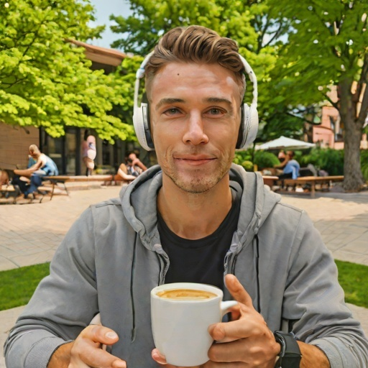
From a Zoom-like Frame to a Behavior Vector
Goal: Predict a multi-attribute behavior vector from a single Zoom-like image.
Output: y = [Gaze, Headphones, Environment, Privacy, Object-in-hand]
Example: [Camera, With_Headphones, Outdoor, Public, Cup]
Why it matters: Enables scalable analysis of learning conditions in remote settings.
Novelty: A dedicated dataset + controllable synthetic data generation.

Slide 3

Project Pipeline: From Idea to a Trained Model
Problem Definition - Define the behavior vector and prediction task.
Real Data Collection - Collect Zoom-like images that match the target scenario.
Synthetic Data Generation - Generate controllable samples to expand coverage and balance classes.
Labeling & Guidelines - Create consistent labels using clear rules for each attribute.
Dataset Preparation - Clean, split, and balance the dataset (train/validation/test).
Baseline Training - Train a baseline multi-head model for initial performance.
Model Refinement & Evaluation - Improve the final model and evaluate per-attribute metrics.

Slide 4

Data Creation & Labeling
Real Data (~900):
Self-captured Zoom-like images + a small curated online set.
~200 fully labeled + ~700 labeled for Gaze only.
Synthetic Data (~2000):
Sample behavior vector → auto-labels (Gaze/Headphones/Env/Privacy/Object).
SDXL Turbo (Text-to-Image) - generate Zoom-like image from a prompt template.
Inpainting (Background replacement): keep the person fixed (mask) + change background to control Environment/Privacy (labels updated)
Prompt Examples:
T2I: webcam zoom call, student, looking at camera, holding phone, indoor, realistic.
Inpaint BG: busy public coffee shop background / quiet private bedroom background.

Slide 5
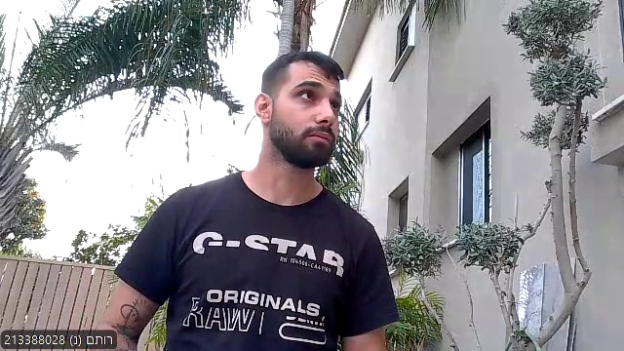
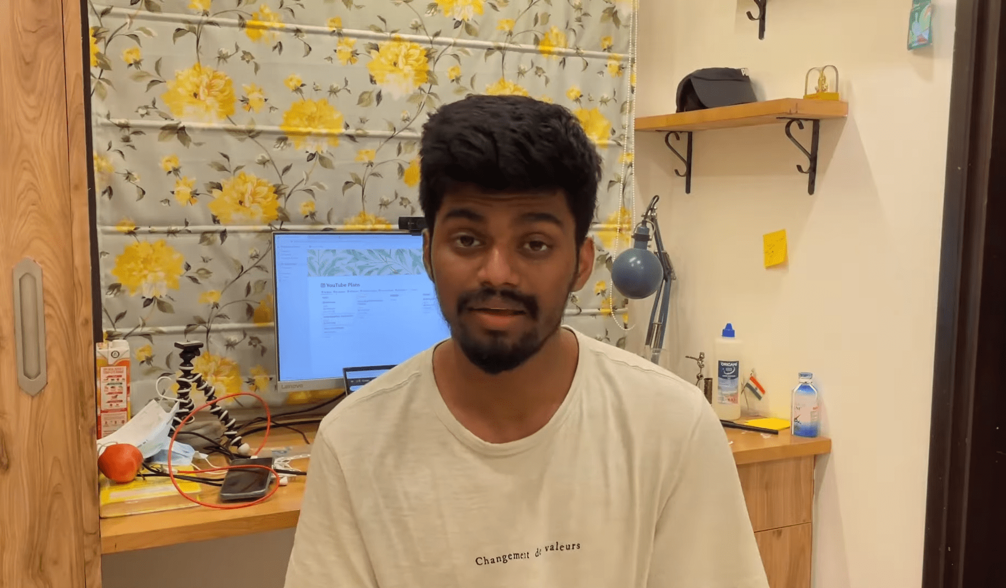
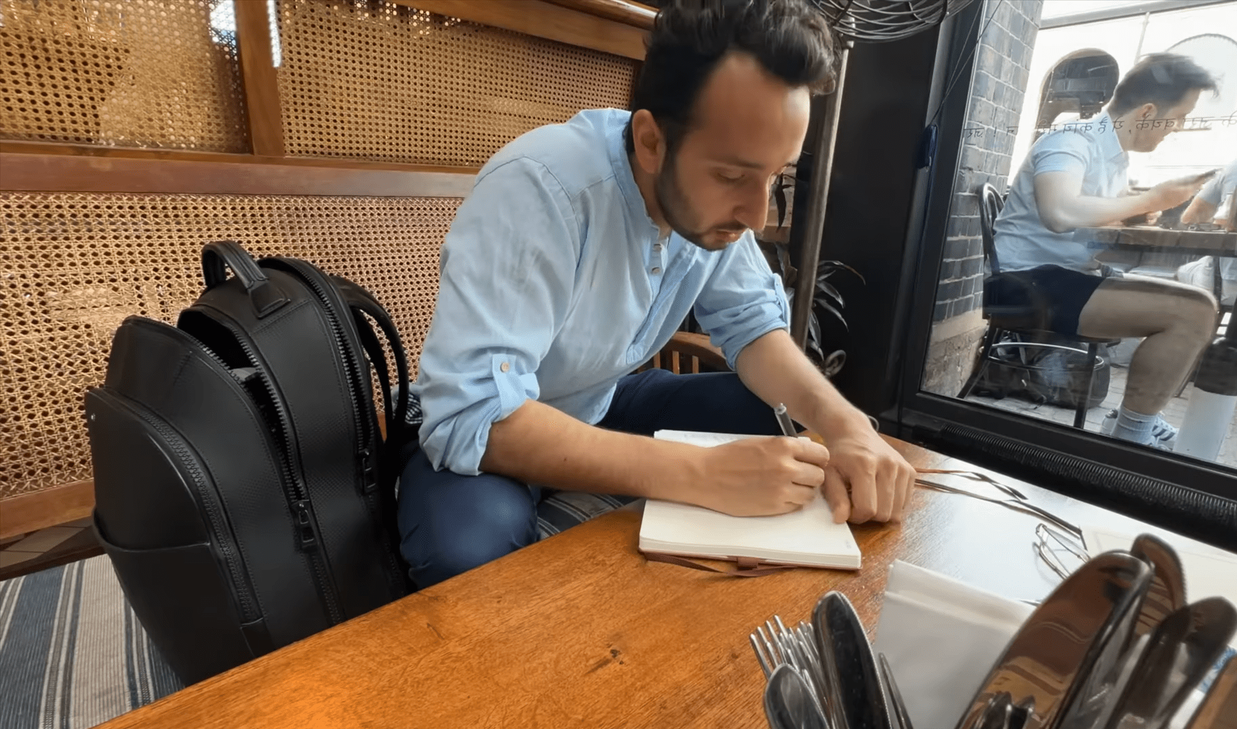


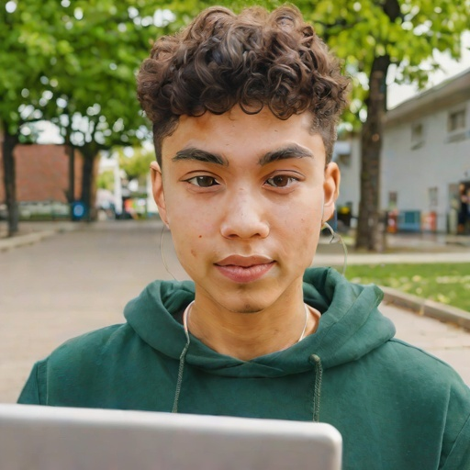


Examples
Environment
Headphones
Gaze

Slide 6




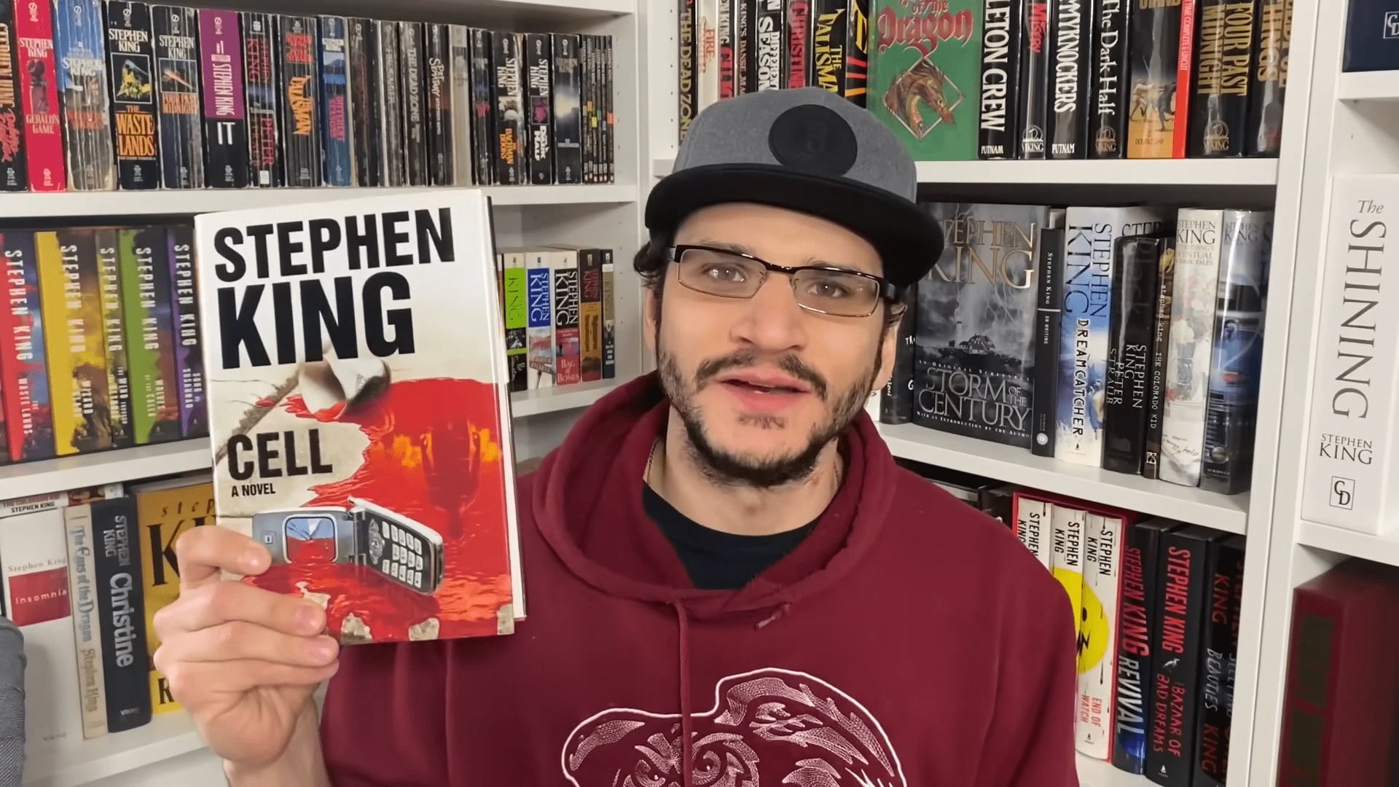
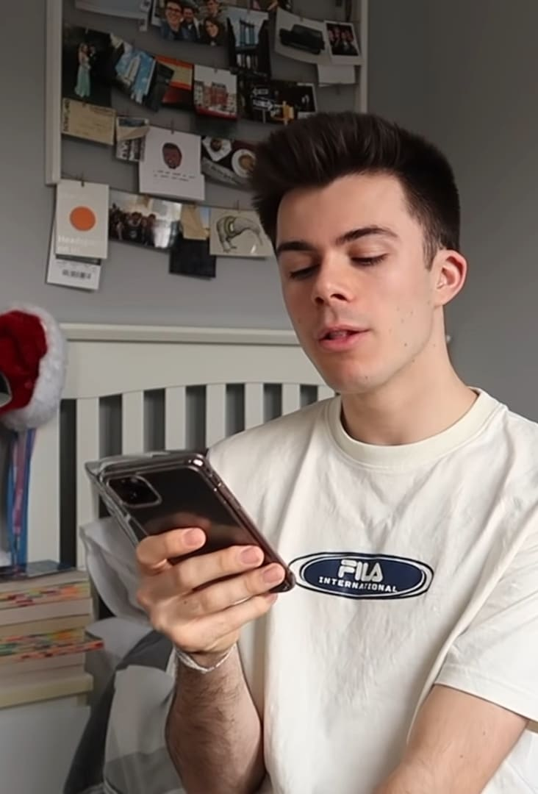
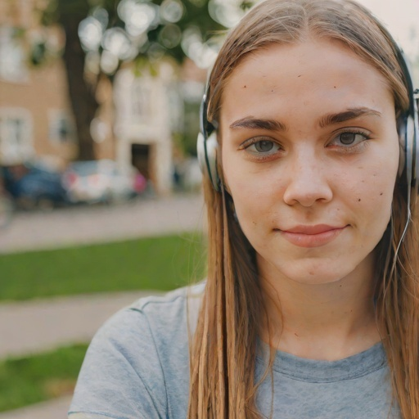
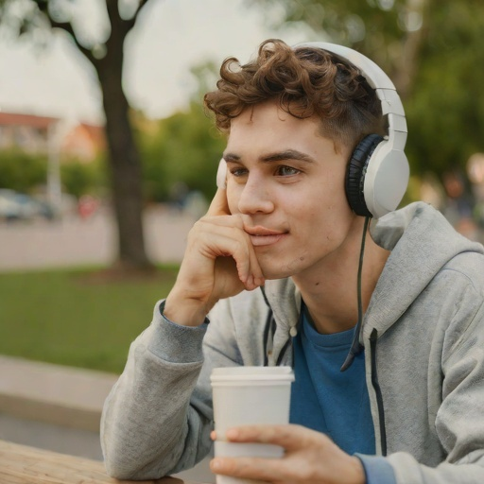
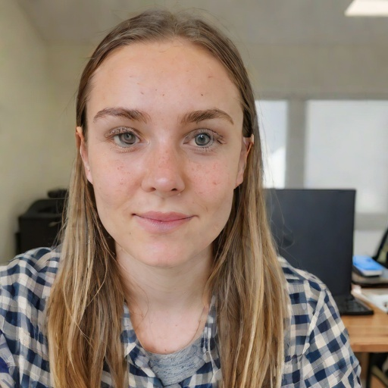
Privacy
Object in hand

Slide 7

Models, Training & Evaluation
Baseline:
ResNet-18 (pretrained), multi-head (one head per attribute).
Final Model:
DeiT-Base (pretrained), multi-head.
Fine-tuned end-to-end (224×224).
Switched to a Transformer-based model after baseline overfitting.
Evaluation:
Per-feature Accuracy + Macro-F1
Overall: Mean Accuracy + Joint Accuracy (all 5 correct)
80/10/10 split, real-only test set.
Confusion matrix (Object) for error analysis.

Slide 8

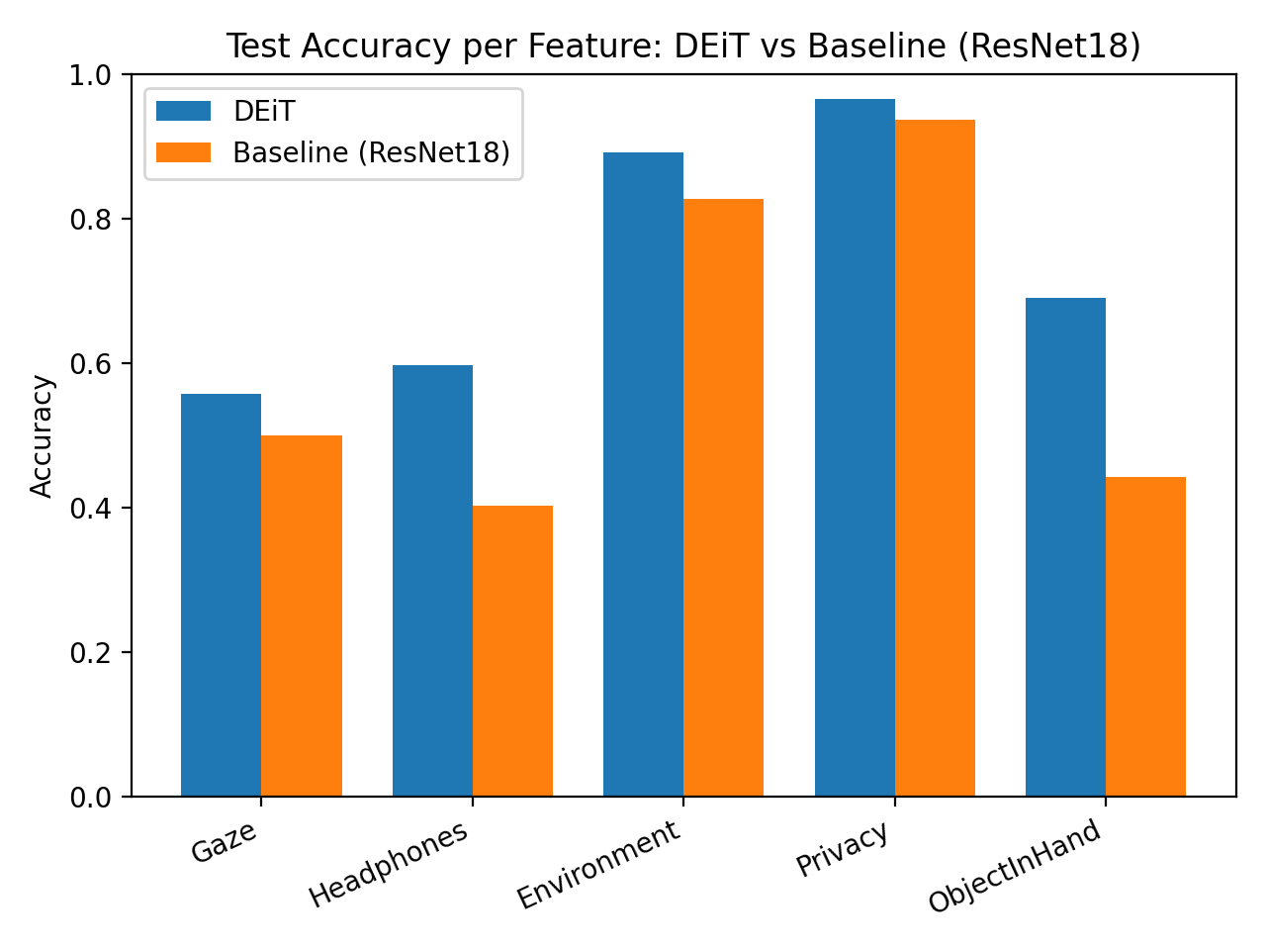
Results: Accuracy per Feature
Multi-task, evaluated on a real-only test set (80/10/10 split).
DeiT consistently outperforms the ResNet-18 baseline.
Strongest: Privacy & Environment | Most challenging: Gaze & Object-in-Hand.

Slide 9
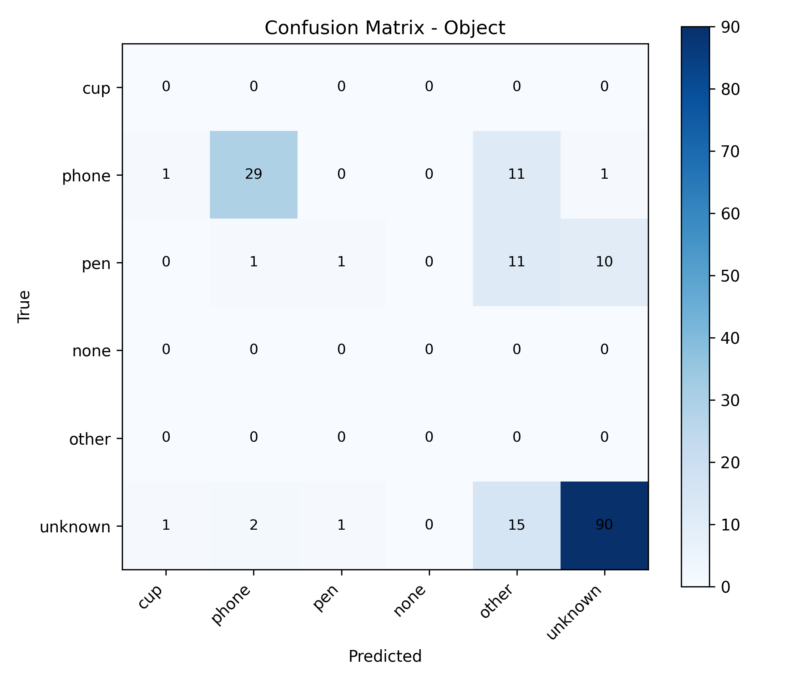
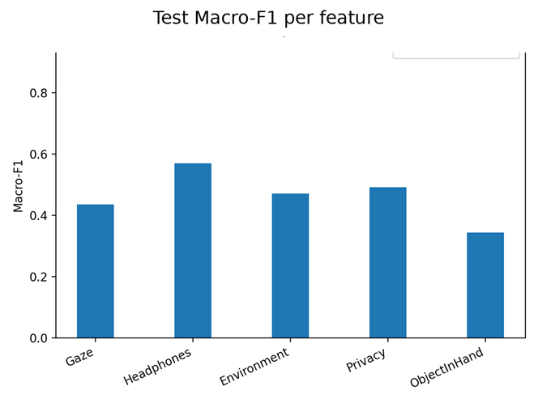
Results: Macro-F1 & Error Analysis
Macro-F1 (class-balanced ): strongest on Headphones, weakest on Object-in-Hand (harder task).
Object confusion matrix: most errors are between phone / other / unknown (similar shapes + occlusions).

Slide 10

Key Achievements:
Built a Zoom-like dataset (~2,900 images): ~900 real + ~2,000 synthetic.
Trained a multi-task, multi-head DeiT model and improved the baseline (ResNet-18 → DeiT).
Key Takeaways:
Real-only test set is critical for measuring real-world performance
Strongest: Privacy & Environment | Most challenging: Gaze & Object-in-Hand.
Future Work:
Extend from single-frame prediction to video-level focus estimation by aggregating frame-wise vectors.
Improve Object-in-Hand with more real data and better class balance (reduce confusion: phone / other / unknown).
Summary & Future Work

